Slide 1
Smart Home Environment Monitoring and Intelligent Anti-Theft Alarming System
TMP-23-054

Slide 2
OVERVIEW
Introduction
Objectives
Overall Design Diagram
Background
Research Gap
Main and Sub Objectives
Research Questions
Methodology
Functional & Non-functional Requirements
Technologies to be Used
Work Breakdown Structure
Project Progress Completion
References
Commercialization
Q & A

Slide 3
Supervisor Panel
SUPERVISOR
C0-SUPERVISOR
Mrs. Narmada Gamage
Mrs. Sasini Wellalage

Slide 4





MEET THE TEAM
01
Leader Sunil Gunasinghage R.W
02
03
04
M.M.S. Silva
J.S.P.A Ekanayake
R.K. Kodikara
IT20212704
IT20383770
IT20185534
IT20182182
CSNE
CSNE
CSNE
CSNE

Slide 5
INTRODUCTION

Slide 6

INTRODUCTION
Home security has become a major factor to be considered due to the rising rates of theft and burglary in modern society.
Smart Home concept is the most recent solution invented to resolve such security problems in modern homes.
Anomaly detection is also a key concept in the smart home systems where, unusual events are detected, and homeowners are alerted on these events

Slide 7
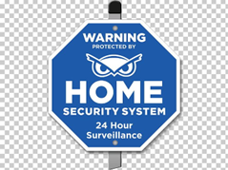
INTRODUCTION Cont.
Typical security systems for modern homes are built on static rules and thresholds that can be easily gotten around by knowledgeable burglars.
Also, the application of such measures may result in erroneous alarms, which could be annoying for homeowners.
To better protect against threats and reduce false alarms, smart home concept needs to take a much more sophisticated and adaptive approach.

Slide 8
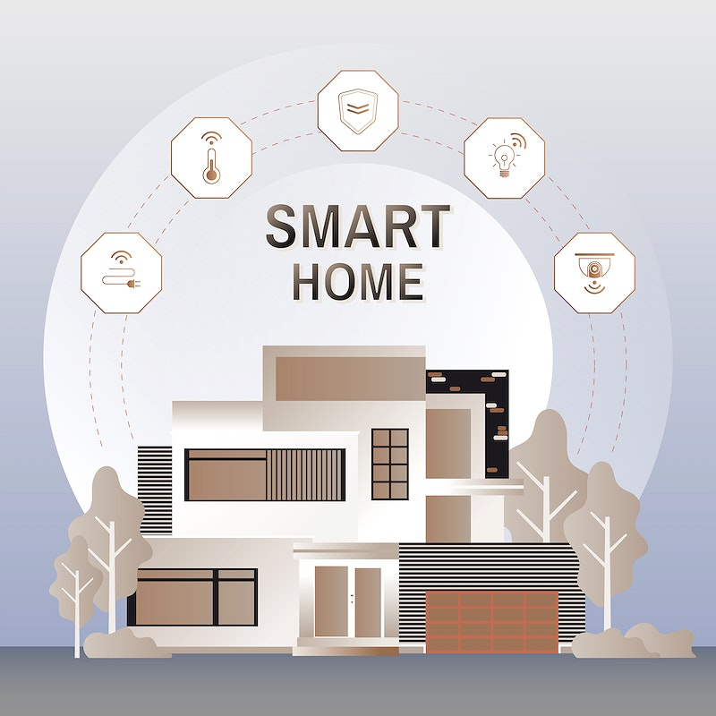
SMART HOME ENVIRONMENT MONITORING AND INTELLIGENT ANTI-THEFT ALARMING SYSTEM
SOLUTION
To overcome these difficulties, Anomaly detection can be introduced.
Unusual event, such as strange sounds or movements, and the deviations from what is deemed to be normal can be detected using anomaly detection.
This cyber threat free ML powered system will monitor the behaviors & Voice patterns of the visitors as well as the Environment

Slide 9

OBJECTIVES
Main objective
Create a cyber-threat free fully functioning smart home monitoring and anti-theft system with enhance the physical security through behavior pattern and voice pattern monitoring and energy saving and protective plug bases.

Slide 10
OBJECTIVES
Sub Objectives
Enhance the physical security in a modern house by preventing intruder access.
Enhance the physical security in a modern house through anomaly(abnormal) voice detection.
Enable secure data communication in a modern house to enhance the physical safety.
Enable electric hazard free environment in a modern house.

Slide 11
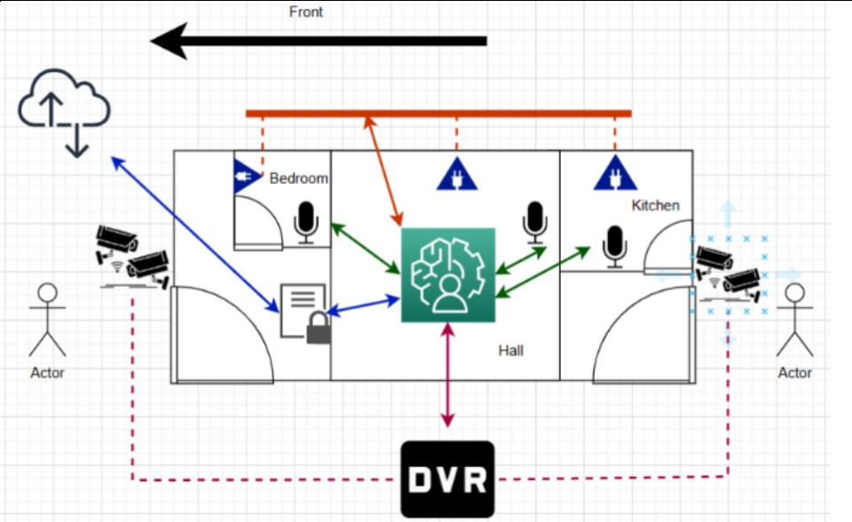

OVERALL DESIGN DIAGRAM
This Photo by Unknown Author is licensed under CC BY-NC

Slide 12
ENHANCE THE PHYSICAL SECURITY IN A MODERN HOUSE BY PREVENTING INTRUDER ACCESS.
Sunil Gunasinghage R.W.
IT20212704

Slide 13
BACKGROUND
Household security and safety are increasingly important issues in the contemporary world.
The proliferation of high-tech security systems and smart homes has given people new options for keeping their homes secure.
The goal of my suggested project component is to develop an intrusion access prevention system for contemporary dwellings that is powered by machine learning.
IT20212704 | Sunil Gunasinghage R.W.| TMP-23-054

Slide 14
BACKGROUND Cont.
Using CCTV images and sophisticated algorithms, this system will keep tabs on how guests act.
Homeowners will receive SMS and email alerts in the event of such conduct, with all the information they need to take preventative measures.
With the help of this plan, modern homeowners will have a secure place to live for themselves and their families.
IT20212704 | Sunil Gunasinghage R.W.| TMP-23-054

Slide 15
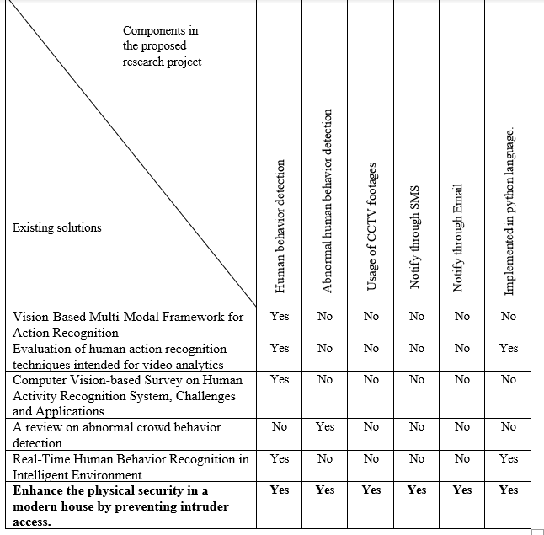
RESEARCH GAP
IT20212704 | Sunil Gunasinghage R.W.| TMP-23-054

Slide 16

MAIN OBJECTIVE
The main objective of this research is to enhance the physical security in a modern house by preventing intruder access.

Slide 17
SUB OBJECTIVES
The ML powered intruder access prevention system has proposed to develop ion the following specific and sub objectives mentioned below.
Create a system that accurately identify the behavior of the guest.
Create a system that accurately understand the behavior of the guest.
Establishment of email and SMS services in notifying procedures.
Integrate the intruder access prevention system with the established email and SMS services.
IT20212704 | Sunil Gunasinghage R.W.| TMP-23-054

Slide 18


RESEARCH QUESTIONS
How to identify and understand the actions of the visitors?
How to implement the SMS and email services?
How to integrate all technologies together?
This Photo by Unknown Author is licensed under CC BY-NC

Slide 19

RESEARCH SOLUTION
Development of Machine Learning powered Intruder access prevention system.
It will identify and understand the actions of visitors through monitoring the installed CCTV camera footages by comparing the datasets.
It will inform the owner of the house through a SMS and email if there was any abnormal action performed by the visitor.

Slide 20
METHODOLOGY
Conduct a literature review: Gather and analyze relevant research papers, reports, and case studies related to behaviour monitoring and intruder access prevention mechanisms.
Collect data: Conduct data collection using the selected research methods.
Analyze data: Use appropriate data analysis techniques to process and interpret the collected data.

Slide 21
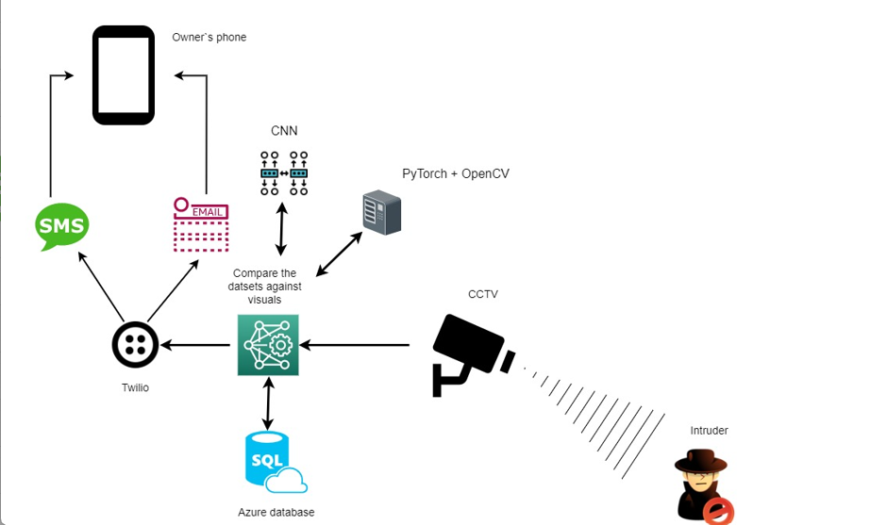
METHODOLOGY Cont.

Slide 22
FUNCTIONAL & NON-FUNCTIONAL REQUIREMENTS
Functional
Non-Functional
Action Detection
Abnormal action Detection
Record the Abnormal behavior Patterns
Provide Real-time Alerts
Secure and Protect User Data
Reliable and Available

Slide 23



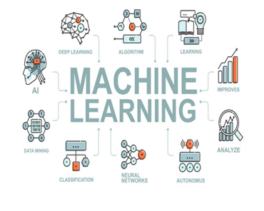
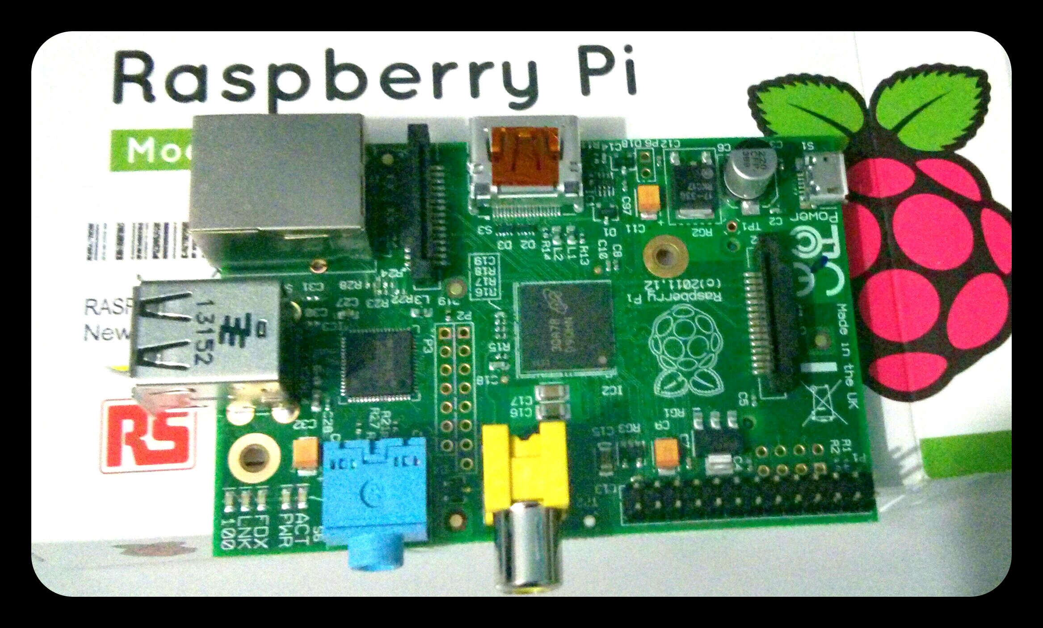
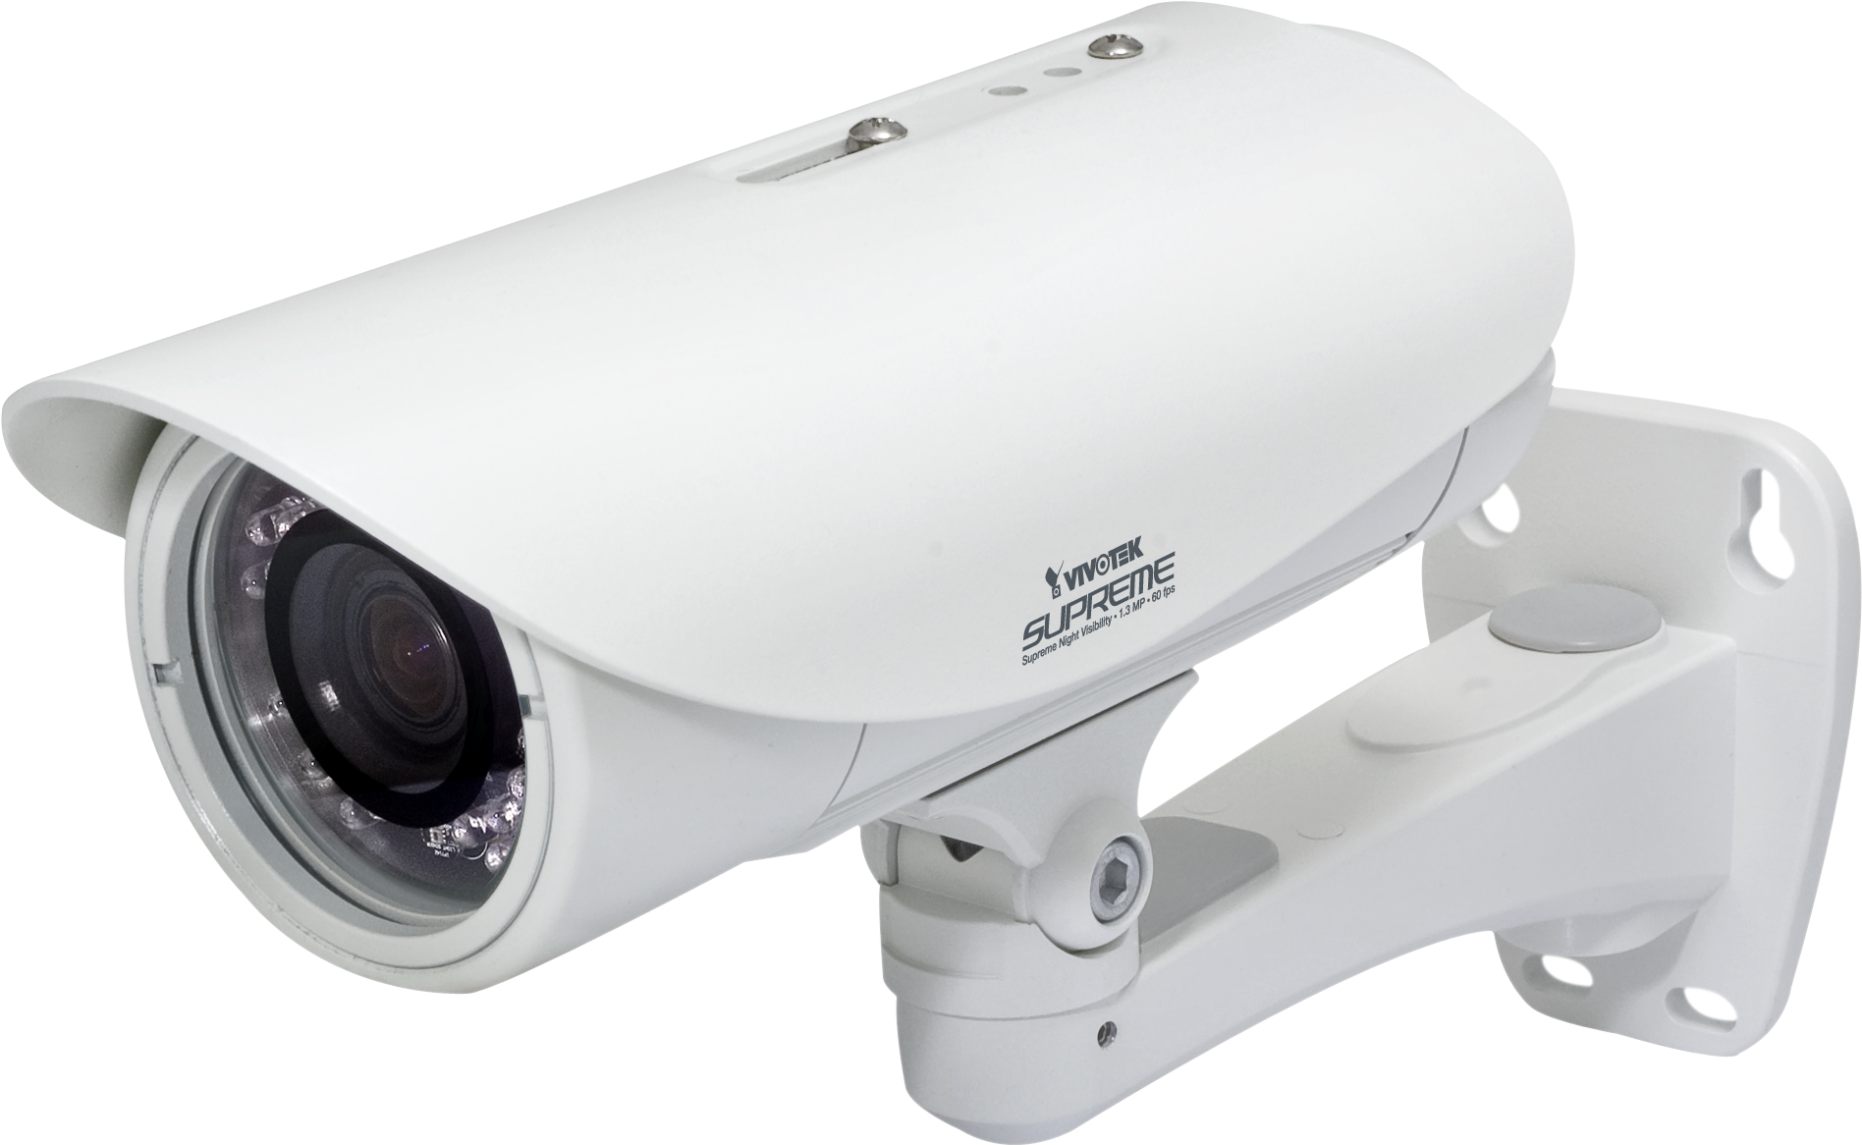
TECHNOLOGIES TO BE USED
Software Requirements
Programming Language - Python
Framework - PyTorch
Communication Library - Twilio
Cloud service for storing data - Microsoft Azure
Hardware Requirements
Raspberry PI
CCTV cameras
Network Devices
This Photo by Unknown Author is licensed under CC BY-NC

Slide 24
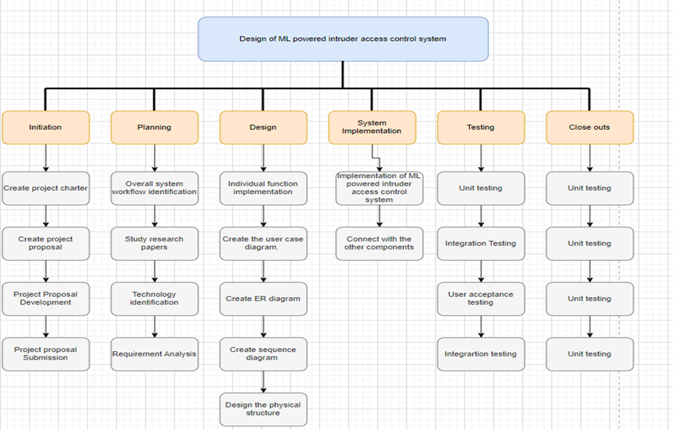
WORK BREAKDOWN STRUCTURE

Slide 25
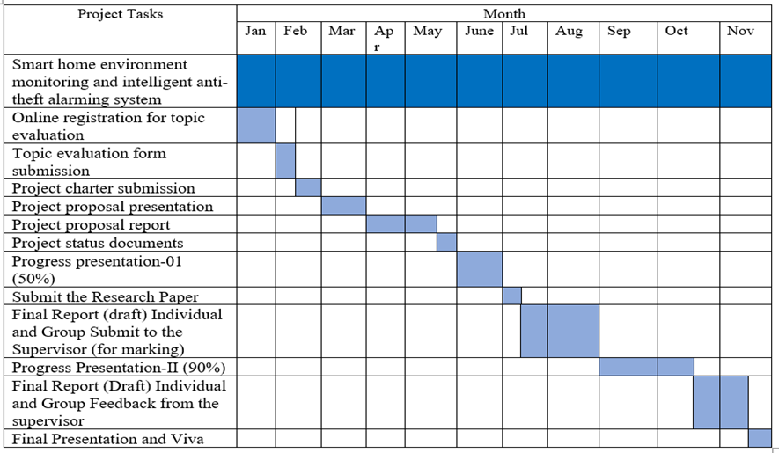
PROJECT PROGRESS COMPLETION

Slide 26
REFERENCE
[1] B. D. Romaissa, O. Mourad and N. Brahim, "Vision-Based Multi-Modal Framework for Action Recognition," 2020 25th International Conference on Pattern Recognition (ICPR), Milan, Italy, 2021, pp. 5859-5866, doi: 10.1109/ICPR48806.2021.9412863.
[2] S. R. Rashmi, S. Bhat and V. C. Sushmitha, "Evaluation of human action recognition techniques intended for video analytics," 2017 International Conference On Smart Technologies For Smart Nation (SmartTechCon), Bengaluru, India, 2017, pp. 357-362, doi: 10.1109/SmartTechCon.2017.8358396.
[3] A. M. F and S. Singh, "Computer Vision-based Survey on Human Activity Recognition System, Challenges and Applications," 2021 3rd International Conference on Signal Processing and Communication (ICPSC), Coimbatore, India, 2021, pp. 110-114, doi: 10.1109/ICSPC51351.2021.9451736.
[4] K. Rohit, K. Mistree and J. Lavji, "A review on abnormal crowd behavior detection," 2017 International Conference on Innovations in Information, Embedded and Communication Systems (ICIIECS), Coimbatore, India, 2017, pp. 1-3, doi: 10.1109/ICIIECS.2017.8275999.
[5] Y. Yuan, Z. Miao and S. Hu, "Real-Time Human Behavior Recognition in Intelligent Environment," 2006 8th international Conference on Signal Processing, Guilin, China, 2006, pp. , doi: 10.1109/ICOSP.2006.345793.

Slide 27

ENHANCE THE PHYSICAL SECURITY IN A MODERN HOUSE THROUGH ANOMALY VOICE DETECTION.
M.M.S. Silva
IT20383770

Slide 28
BACKGROUND
Human communication almost 70% is based on speech.
The workload of the future world however depends on machines rather than manual work.
Even the most sophisticated anti-theft security systems include voice recognition technology, they have failed to incorporate advanced voice recognition functions in their security systems.
IT20383770 | M.M.S. Silva TMP-23-054

Slide 29
BACKGROUND Cont.
In fact, these systems are incapable of distinguishing between the owners of the concerned property and strangers or trespassers using the voice/sound patterns.
Also, the current security systems are unable to identify whether these people pose a threat to the system or not.
So, there’s a demand for an advanced security system which have enhanced features to overcome above challengers.
IT20383770 | M.M.S. Silva TMP-23-054

Slide 30
RESEARCH GAP
Lack of research on the effectiveness of anomaly voice detection in modern houses.
Limited research on the accuracy of anomaly voice detection systems.
Limited research on the integration of anomaly voice detection systems with other security measures.
Limited research on the effects of false positives and false negatives.

Slide 31
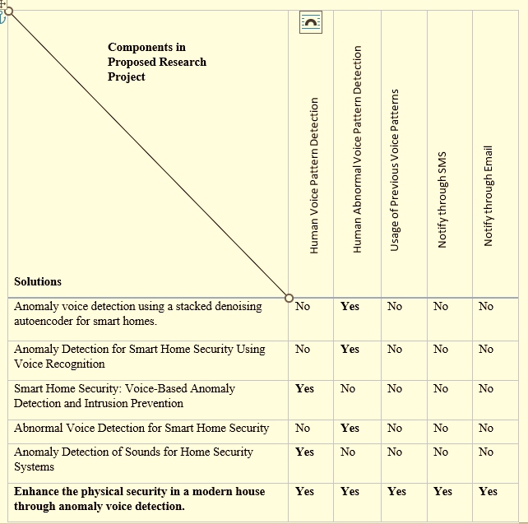

Slide 32
MAIN OBJECTIVE
Enhance the physical security in a modern house through anomaly (abnormal) voice detection.

Slide 33
SUB OBJECTIVES
To assess the accuracy and reliability of anomaly voice detection systems in identifying abnormal voices in various situations.
To evaluate the level of technical expertise needed to use the system and how simple it is to install and maintain, as well as the usability of anomaly voice detection systems for homeowners.
The overall goal of the research is to provide recommendations for the future development and application of the technology.

Slide 34


RESEARCH QUESTIONS
What is the state of physical security in modern homes and what are the limitations of traditional security measures?
What kinds of anomalies can be identified using technology for anomaly voice detection, and how does it operate?
What ethical and legal issues are raised by using anomaly sound detection technology in contemporary homes, and how can these issues be resolved?
How can anomaly sound detection technology be combined with other home security features like motion detectors and security cameras?

Slide 35

RESEARCH SOLUTION
Capture different types of voices and sounds using an array of microphones.
Compare the obtained voice-clips with the prerecorded ones in the data base of the security system.
Prompt feedback to the owner of the in case of an anomaly from the recorded data is detected.
With each sound captured, the database is updated accordingly.

Slide 36
METHODOLOGY
The First Step - Comprehensive literature review
The Second Step - Data Collection(Utilizing information from recorded conversations, several anomalous voice types including violent or suspicious behavior, unlawful access)
The Third Step - The creation of a prototype sound detection system (The prototype will be evaluated and improved)
It was decided to use Python language to implement the logical part and this system will be implemented on a Raspberry Pi board
The Fourth Step - The creation of protocols and instructions
The Fifth Step - Field testing

Slide 37
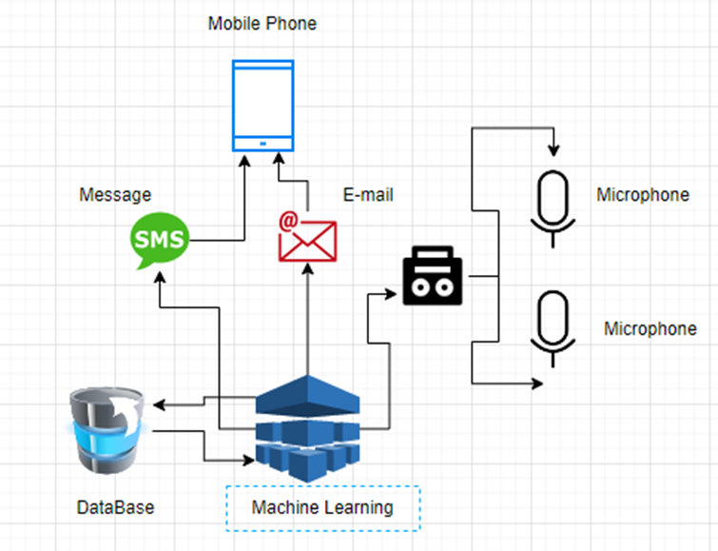
METHODOLOGY Cont.

Slide 38
FUNCTIONAL & NON-FUNCTIONAL REQUIREMENTS
Functional
Non-Functional
Voice Detection
Anomaly Voice Detection
Record the Abnormal Voice Patterns
Computing Degree of Threat
Provide Real-time Alerts
Secure and Protect User Data
Reliable and Available
Scalable and Adaptable

Slide 39
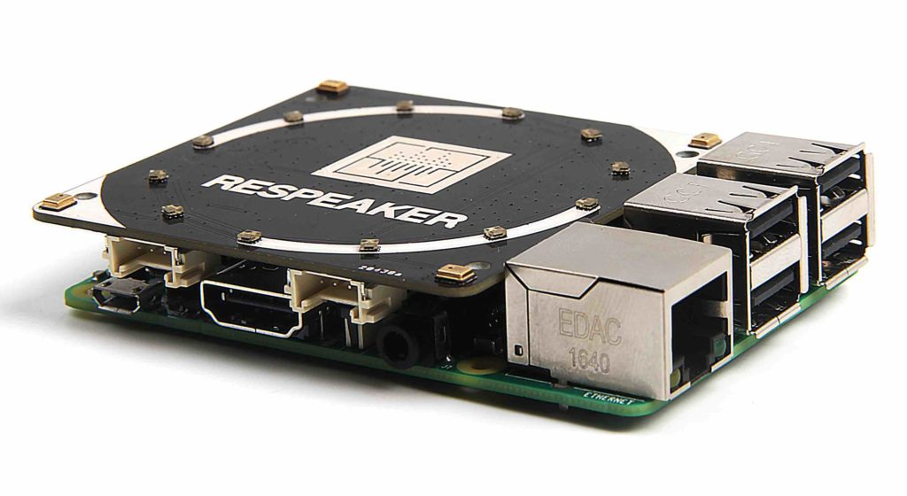
TECHNOLOGIES TO BE USED
Software Requirements
Programming Language - Python
Framework - PyTorch
Communication Library - Twilio
Cloud service for storing data - Microsoft Azure
Hardware Requirements
Raspberry PI
Microphone Array
Network Devices

Slide 40
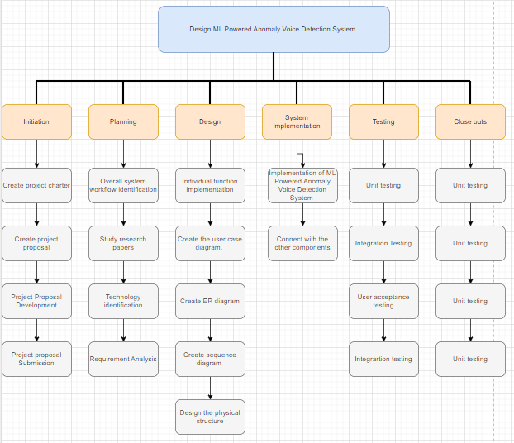
WORK BREAKDOWN STRUCTURE

Slide 41
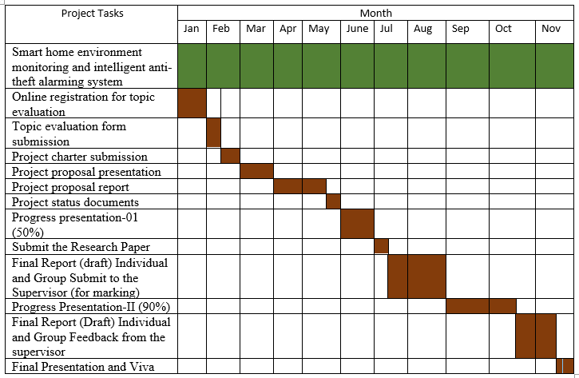
PROJECT PROGRESS COMPLETION

Slide 42
REFERENCE
[1] D. Kim, C. Hwang and T. Lee, "Stacked-autoencoder based anomaly detection with Industrial Control System," Software Engineering, Artificial Intelligence, Networking and Parallel/Distributed Computing, p. 191, 202
[2] Y. Sun, J. Yang and C.-H. Hsu, "Anomaly Detection for Smart Home Security Using Voice Recognition," IEEE Transactions on Industrial Informatics, vol. 15, no. 6, pp. 3218-3226, 2019
[3] A. Ghandeharioun and R. W. Picard, "Smart Home Security: Voice-Based Anomaly Detection and Intrusion Prevention," IEEE Transactions on Multimedia, vol. 19, no. 4, pp. 807-819, 2017.
[4] Z. Yao, H. Yao and X. Zhang, "Abnormal Voice Detection for Smart Home Security," IEEE Transactions on Multimedia, vol. 21, no. 4, pp. 973-985, 2019.
[5] I. R. Parameshwaran and R. Prakash, "Anomaly Detection of Sounds for Home Security Systems," IEEE Sensors Journal, vol. 18, no. 22, pp. 9233-9242, 2018.
[6] V. Priya, R. V. and . K. V. , "Secure Smart Home System Using Anomaly Detection," 2020 International Conference on Communication and Signal Processing (ICCSP), pp. 0893-0898, 2020.
[7] A. S. Adhav and S. G. Kulkarni, "Smart Home Security System Using Anomaly Detection with Deep Learning," 2021 International Conference on Data Science and Communication (IconDSC), Pune, India, pp. 1-6, 2021.

Slide 43
ENABLE SECURE DATA COMMUNICATION IN A MODERN HOUSE TO ENHANCE THE PHYSICAL SAFETY.
J.S.P.A. Ekanayake
IT20108922

Slide 44
BACKGROUND
IoT devices are often designed with limited security measures, making them easy targets for cyber criminals. Additionally, the sheer volume and diversity of IoT devices makes it difficult to implement standard security protocols across all devices. As a result, IoT systems are increasingly vulnerable to a variety of cyber-attacks, including malware infections, denial-of-service attacks, and data theft.
IT20108922 | J.S.P.A. Ekanayake TMP-23-054

Slide 45
BACKGROUND Cont.
This system enhances the physical security of a house, but what happens if sabotaged it by using a cyber-attack?
This research focuses on how to secure IoT devices in smart homes, specifically home monitoring and anti-theft systems. The discussion will revolve around the use of these technologies to detect and prevent intrusions and potential security breaches, enhancing the safety and privacy of homeowners.
IT20108922 | J.S.P.A. Ekanayake TMP-23-054

Slide 46
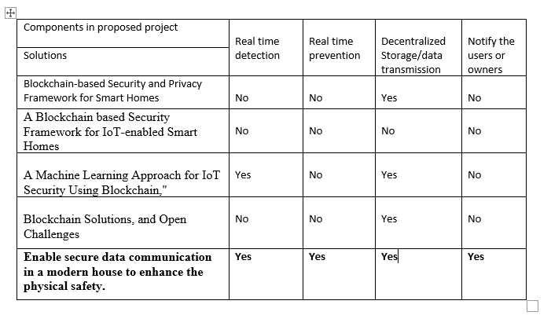
RESEARCH GAP

Slide 47
MAIN OBJECTIVE
Enable secure data communication in a modern house to enhance the physical safety.

Slide 48
SUB OBJECTIVES
Conduct more research on adversarial attacks
Develop a Machine learning model to detect cyber threats by analyzing the network traffic and prevent cyber threats.
Develop a Blockchain based solution to store data securely and transmit data without getting theft.

Slide 49
RESEARCH QUESTIONS
How to detect threats and response in real-time?
How to address privacy concerns?
How to prevent data tempering and theft?

Slide 50
METHODOLOGY
Conduct a literature review: Gather and analyze relevant research papers, reports, and case studies related to IoT security. Identify best practices, frameworks, and standards for securing IoT systems from cyber threats.
Collect data: Conduct data collection using the selected research methods.
Analyze data: Use appropriate data analysis techniques to process and interpret the collected data. For example, use statistical analysis to identify patterns and trends in the data.
Develop a security solution: Based on the research findings, propose a security solution that addresses the identified vulnerabilities and meets the system requirements.

Slide 51
METHODOLOGY
Implement the security solution: Test and implement the proposed security solution in the IoT system
Evaluate the security solution: Conduct a post- implementation evaluation of the security solution to assess its effectiveness in mitigating cyber threats.

Slide 52
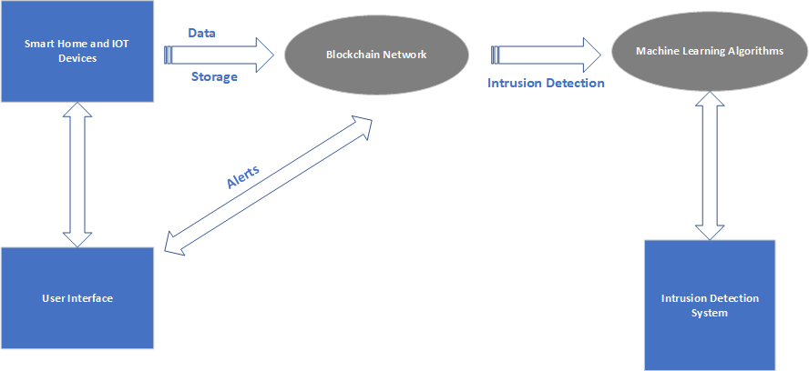
METHODOLOGY

Slide 53
FUNCTIONAL & NON-FUNCTIONAL REQUIREMENTS
Functional
Non-Functional
Detecting the cyber attacks Realtime
Preventing the cyber-attacks Realtime
Preventing the modification and theft of data
Availability
Security

Slide 54
TECHNOLOGIES TO BE USED
Machine Learning
Random Forest
Support vector Machines
Python
Blockchain

Slide 55
WORK BREAKDOWN STRUCTURE

Slide 56
PROJECT PROGRESS COMPLETION

Slide 57
REFERENCE
"A Comprehensive Survey of IoT Security: Threats, Vulnerabilities, and Solutions" by S. Sicari et al.
"Securing the Internet of Things: A Survey on Current Challenges and Solutions" by M. Al-Fuqaha et al.
"Security and Privacy Challenges in the Internet of Things" by R. Roman et al.
"IoT Security: Review, Blockchain Solutions, and Open Challenges"
"Blockchain-based Security and Privacy Framework for Smart Homes" by S. K. Das et al.

Slide 58
ENABLE ELECTRIC HAZARD-FREE ENVIRONMENT IN A MODERN HOUSE.
R. K. Kodikara
IT20182182

Slide 59
BACKGROUND
Providing a smart plug base to the home environment for security
Monitor the motions, LP Gas leak, current, and unique voice and can control
Smart plugs for home appliances can reduce electricity wastage.
Provides protection for home and household electrical appliances
IT20182182 | R.K. Kodikara| TMP-23-054

Slide 60
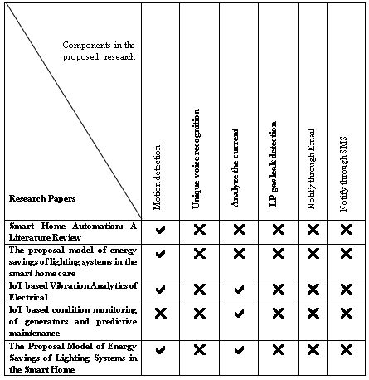
RESEARCH GAP

Slide 61
MAIN OBJECTIVE
Enable electric hazard free environment in a modern house.

Slide 62
SUB OBJECTIVES
Detect the unique voice command and turn on/off the plug base
Detect the motions and turn off the plug base if there is no motions
Detect the LP Gas and turn off the plug base
Detect the unique voice command and turn on/off the plug base

Slide 63
RESEARCH QUESTIONS
How to turn off the plug using voice?
How to reduce electricity wastage?
How to do everyday household chores efficiently, easily and quickly?
How to protect yourself from fire in household work?

Slide 64
METHODOLOGY
Step 1 – Monitor the motions, LP Gas leak, current, and unique voice
Step 2 – Detect the if no motion, LP Gas leak and voice
Step 3 – If it’s detected turn off the plug base
Step 4 – end of the process send a SMS to the house owner

Slide 65
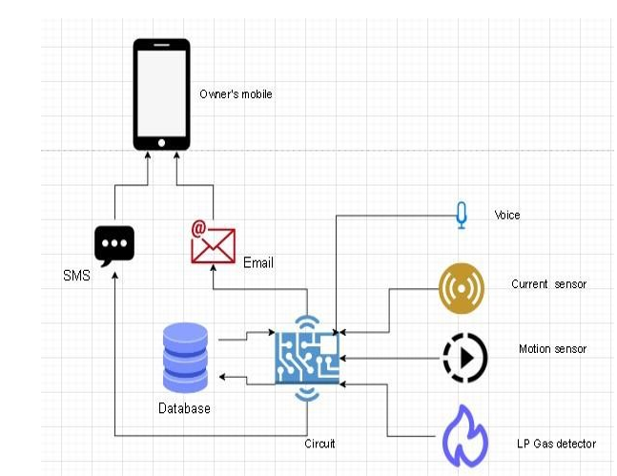
METHODOLOGY

Slide 66
FUNCTIONAL & NON-FUNCTIONAL REQUIREMENTS
Functional Voice detection Motion detection LP gas detection Monitor the Current usage
Non-Functional Protect household appliances Reliable Available

Slide 67
TECHNOLOGIES TO BE USED
Machine Learning (ML)
Internet of Things (IoT)
Python
Arduino

Slide 68
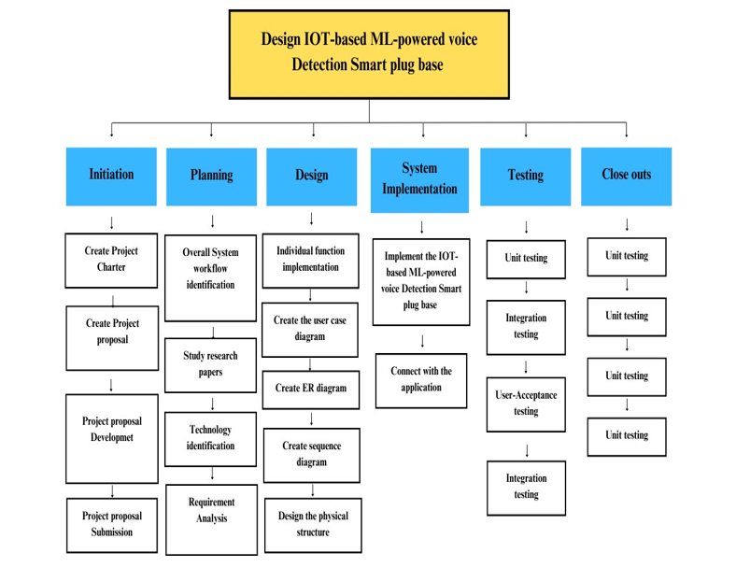
WORK BREAKDOWN STRUCTURE

Slide 69
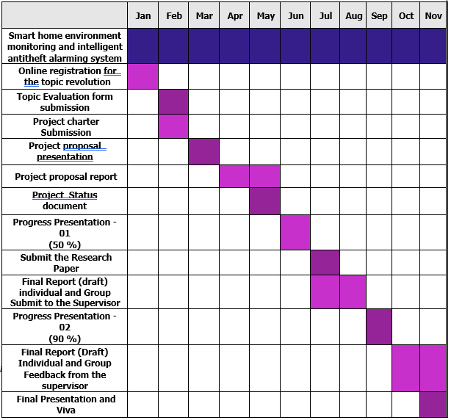
PROJECT PROGRESS COMPLETION

Slide 70
REFERENCE
[1] P. S. Y. Vaishnavi S. Gunge, "Smart Home Automation: A Literature Review," Computer Applications, pp. 06-10, 2016.
[2] J. Vanus, T. Novak, J. Koziorek, J. Konecny, and R. Hrbac, “The proposal model of energy savings of lighting systems in the smart home care,” IFAC proc. vol., vol. 46, no. 28, pp. 411–415, 2013.
[3] Researchgate.net. [Online]. Available: https://www.researchgate.net/publication/251838675_The_development_of_smart_switch_system_for_the_automation_system_in_power_utilities. [Accessed: 18-Aug-2022].
[4] V. R. D.Ganga, "IoT based Vibration Analytics of Electrical," pp. 01-12, 2017.
[5] T. S. Gunawan et al., “Prototype design of smart home system using Internet of Things,” Indones. j. electr. eng. comput. sci., vol. 7, no. 1, p. 107, 2017.
[6] D. S. T. A. K. Md. Yaseen, "IoT based condition monitoring of generators and predictive maintenance," IEEE, Coimbatore, 2017.
[7] T. N. J. K. J. K. R. H. J. Vanus, "The Proposal Model of Energy Savings of Lighting Systems in the Smart Home," Department of Cybernetics and Biomedical Engineering, VSB TU Ostrava, elke Karlovice, Czech Republic, 2013.

Slide 71
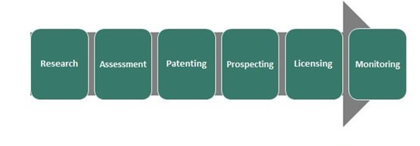
COMMERCIALIZATION

Slide 72


THANK YOU!
Do you have any questions?

